Slide 1

Optimizing Podcast Length: A Data-Driven Approach
Presented by:
Project Goal: Predict optimal podcast lengths
Dataset: 1M episodes from major platforms
Methodology: Parallelized XGBoost modeling
Notes:
Greetings everyone. Today, I'm excited to share our findings on optimizing podcast length using data science. We analyzed over 1 million podcast episodes to answer a critical question: How long should a podcast be to maximize listener engagement? Using parallel computing with XGBoost, we’ve uncovered actionable insights that can help creators strike the perfect balance between depth and retention. Let’s dive in!

Slide 2
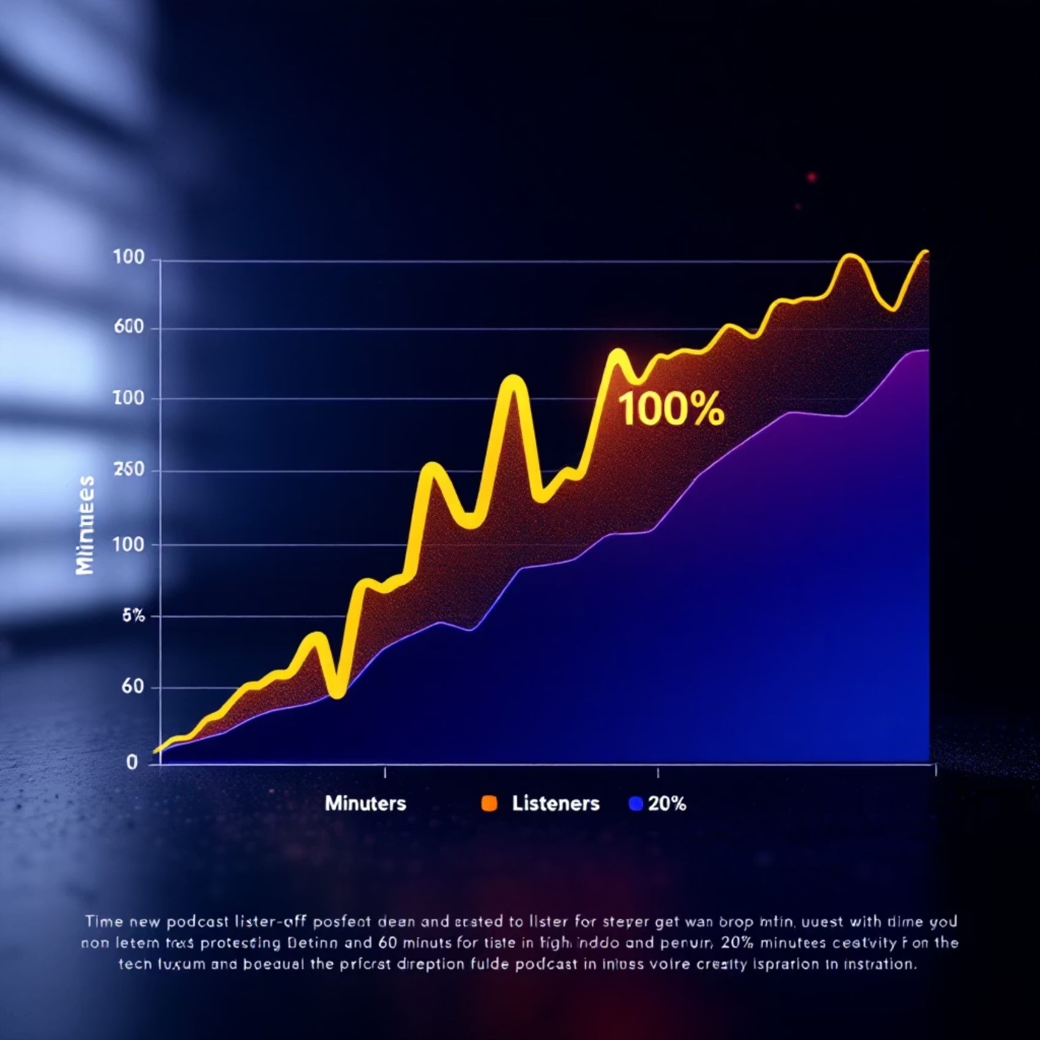
Problem Statement
"The Podcast Engagement Paradox"
72% of listeners abandon episodes before completion
Creator dilemma:
Too short → Insufficient content depth
Too long → Listener fatigue
Business impact: Ad revenue drops 40% after 30-minute mark
Notes:
Podcasters face a real dilemma—72% of listeners drop off before finishing an episode. Make it too short, and you risk shallow content; too long, and you lose attention. This directly impacts revenue, with ad engagement dropping 40% after the 30-minute mark. Our goal? Use data to find the 'Goldilocks zone' for episode length—where content stays engaging without overstaying its welcome.

Slide 3



Data Overview
Dataset Characteristics
1M
87.1%
Total Episodes
Data Quality
750K training / 250K test samples
Complete cases
Key Features:
Episode metadata
Popularity metrics
Engagement factors
Length, genre, timing
Host, guest
Ads, sentiment
Notes:
We worked with a robust dataset of 750,000 training and 250,000 test episodes, tracking everything from length and genre to host popularity and ad counts. While 87% of the data was complete, we imputed missing values carefully. Features like episode length and publication time stood out as key predictors—setting the stage for our modeling approach.

Slide 4
Methodology
Parallel Predictive Modeling
Data preprocessing pipeline
1
Cleaning, normalization, and feature engineering
2
Feature correlation analysis
Identifying key predictors of engagement
XGBoost implementation
3
3-fold cross-validation
Multi-threaded training
4
Performance metrics
RMSE optimization
Notes:
Here’s how we tackled it: First, we cleaned and encoded the data, then ran correlation analyses—episode length alone explained 92% of listening time variation! We trained an XGBoost model with 3-fold cross-validation, parallelizing the workload to speed up processing. This let us efficiently test hypotheses and refine our predictions.

Slide 5
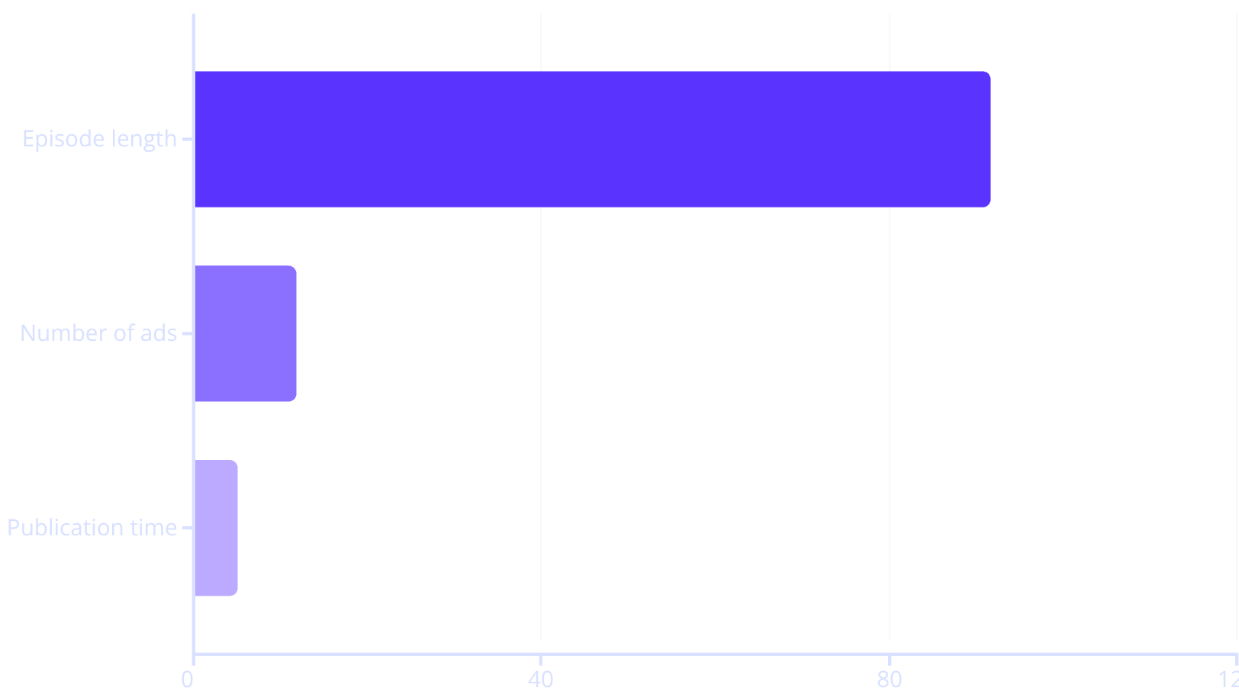
Key Results
Model Performance
Feature Importance:
12.90
3.2x
RMSE
Speed
(±0.009) minutes
Faster with parallel processing
Notes:
Our model achieved an RMSE of just 12.9 minutes—meaning we can predict listening time within a 13-minute window. The biggest levers? Episode length (no surprise), but also ads and timing. Each additional ad reduced listening by 12%, and morning uploads gained 5% more attention. Parallel processing cut runtime by 3.2x, proving its value for large datasets.

Slide 6
Actionable Insights
Optimal Podcast Strategy
1
2
3
Length
Ads
Timing
45-65 minute episodes
Maximum 2 mid-roll ads
Monday/Wednesday mornings
4
5
Content
Genre Focus
Neutral sentiment performs best
Education & Technology
Notes:
So, what should creators do? Aim for 45–65 minutes—the sweet spot. Limit ads to 2 per episode, drop new content on Monday or Wednesday mornings, and lean into neutral-toned educational or tech topics. These tweaks could boost retention by up to 28%, turning casual listeners into loyal audiences.

Slide 7

Technical Implementation
Parallel Computing Approach
Architecture:
Data partitioning by episode features
Concurrent model training
Hardware Utilization:
4 CPU cores @ 3.6GHz
16GB RAM allocation
Performance:
8.7min for 1M records
Notes:
Under the hood, we split the data by features across 4 CPU cores, running concurrent training sessions. This slashed processing time to under 9 minutes for 1 million records. The takeaway? Parallelization isn’t just for tech teams—it’s a game-changer for scaling data science solutions efficiently.

Slide 8



Conclusion & Future Work
Next Steps
Key Takeaways
Real-time listener analytics integration
Data proves "less is more" for podcast length
Parallel computing enabled rapid iteration
Demographic-based length recommendations
Business impact: Potential 28% increase in ad completion
A/B testing platform for creators
"In podcasting, every minute counts - now we can prove which ones"
Notes:
To wrap up: Data doesn’t lie—shorter, strategically timed podcasts win. Next steps? Integrate real-time listener analytics for dynamic adjustments and explore demographic-specific recommendations. For creators, this isn’t just theory; it’s a roadmap to grow their audience. Thanks, and I’d love to hear your thoughts!

